Slide 1

Ethics, Bias, and Fairness Part I:
Overview, Frameworks, and Issues
Rayid Ghani and Kit Rodolfa

Slide 2
Reminders
Grading - module 1 results, mid-term, modules 2 and 3, attendance/participation
Neurips week plan: recorded presentations + review assignment
Next update assignment – due Nov 7th

Slide 3
We know data/ML can help improve society but we have to do it responsibly and ethically

Slide 4
We need to be ok with not having answers but raising more questions that can be empirically informed

Slide 5
Most of these questions are not new
Ethical issues have always existed in every decision-making process
Why are we talking about them in this class now?

Slide 6
Most of these questions are not new
Ethical issues have always existed in every decision-making process but we are dealing with them now at a different scale and with a more data-driven view

Slide 7
Dim Sum is so much better than Sushi

Slide 8
Good research can only happen in academia

Slide 9
My phone should never collect, store, or use my location information

Slide 10
All stereotypes are based on data

Slide 11
All stereotypes are based on some data

Slide 12
Self Driving cars save lives

Slide 13
Predicting whether someone will commit a crime in the future is unethical

Slide 14
Predicting whether someone will commit suicide in the future is unethical

Slide 15
Pittsburgh vs New York

Slide 16
Predictive policing systems reduce crime

Slide 17
Facial Recognition Systems should be banned

Slide 18
The blame for the negative consequences of the WCG system lies with the mayor

Slide 19
The blame for the negative consequences of the WCG system lies with the ML Developers

Slide 20
Data and AI Ethics Issues
Privacy
Data Ownership
Bias, Equity, & Fairness
Transparency
Trustworthiness and Accountability

Slide 21
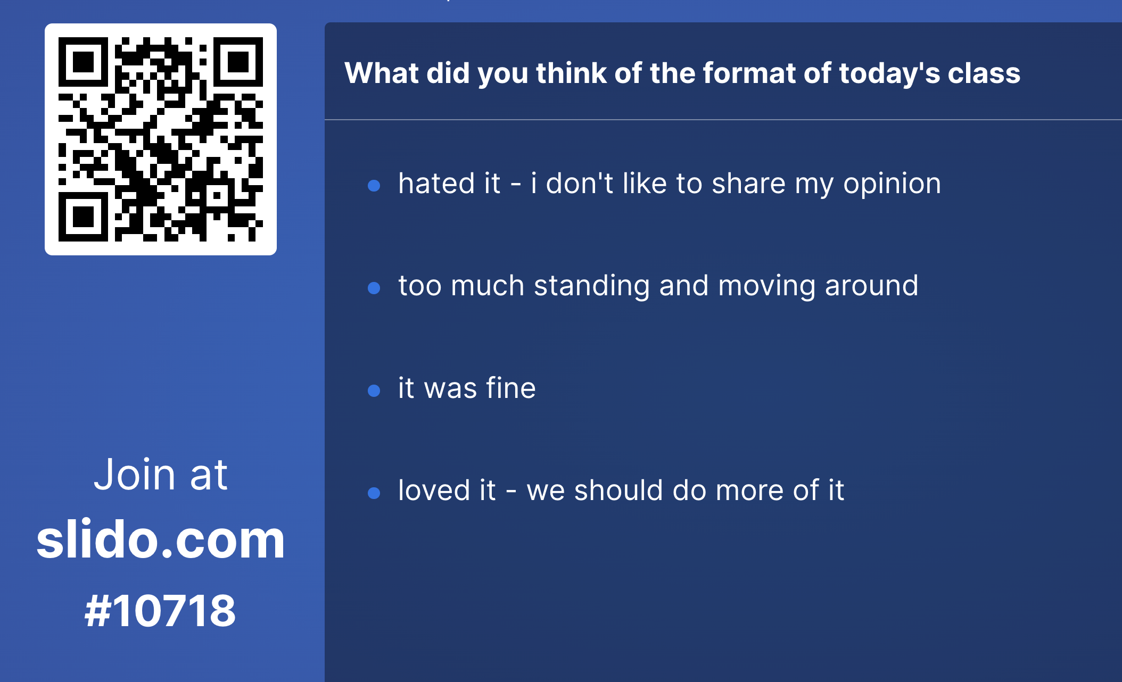

Slide 22
Our policies need to reflect our values
What do we mean by equity?
Is it ok to (reverse) discriminate against one group to reach equity?
Should our right to privacy matter more than our right to life? Or to healthcare?
Should we be allowed to use someone’s data just because it’s accessible to us?
Is predictive policing always bad?

Slide 23
We need to think of & include the perspectives of different groups
Decisionmakers
Public
Media
Analysts

Slide 24
Rawls’s Theory of Justice
Moral philosophy is much more about frameworks to help approach tough problems and balance competing obligations than clear-cut answers
Rawls is far from the only voice here and many other perspectives are well worth exploring: utilitarianism (Singer), deontology (Kant), Scanlon, Sen, etc.

Slide 25
Rawls’s Theory of Justice
Make rules from the “original position” under a “veil of ignorance”
Rawls’s conclusions: equality in rights/duties & the difference principle
Maximize the position of the least-well-off in society (“maximin”)

Slide 26
Some questions we should be asking

Slide 27
Some questions we should be asking
Are you using data for purposes it’s intended for?
How are you protecting the data?
Do the people who “own” the data know you’re using it?
Do you have their permission? How was it obtained?
What actions are you taking on individuals based on this data?
Do the people you’re targeting know why and if they’re being targeted?
What recourse do they have?
Would it make the front page of NYT if they found out what you’re doing?

Slide 28
Data and AI Ethics Issues
Privacy
Data Ownership
Bias, Equity, & Fairness
Transparency
Trustworthiness and Accountability

Slide 29
Data and AI Ethics Issues
Privacy
Data Ownership
Bias, Equity, & Fairness
Transparency
Trustworthiness and Accountability

Slide 30
Privacy, Inference, and Levels of control
While we may want controls at all levels, we want stronger
controls as we go down these levels
(Not collecting my data)
Collection Control
Action Control (Not taking certain actions on me)
Access Control
Inference Control
(Not giving access to my data)
(Not inferring something about me)

Slide 31
Data and AI Ethics Issues
Privacy
Data Ownership
Bias, Equity, & Fairness
Transparency
Trustworthiness and Accountability

Slide 32
Transparency is not about displaying the model that was built

Slide 33
What does it take for an analysis to be transparent?
Code for the analysis
Model that was built
Data that was used
…

Slide 34
We have to be able to explain and disclose
Processes—what the analysis pipeline and algorithm does
How it does it
Who controls the algorithm
What data does it use
What is it being asked to optimize for
How well did it do what it was asked to do
What was its impact on different types of people

